Slide 1

Unit 1 NIFTY & SENSEX

Slide 2


Slide 3
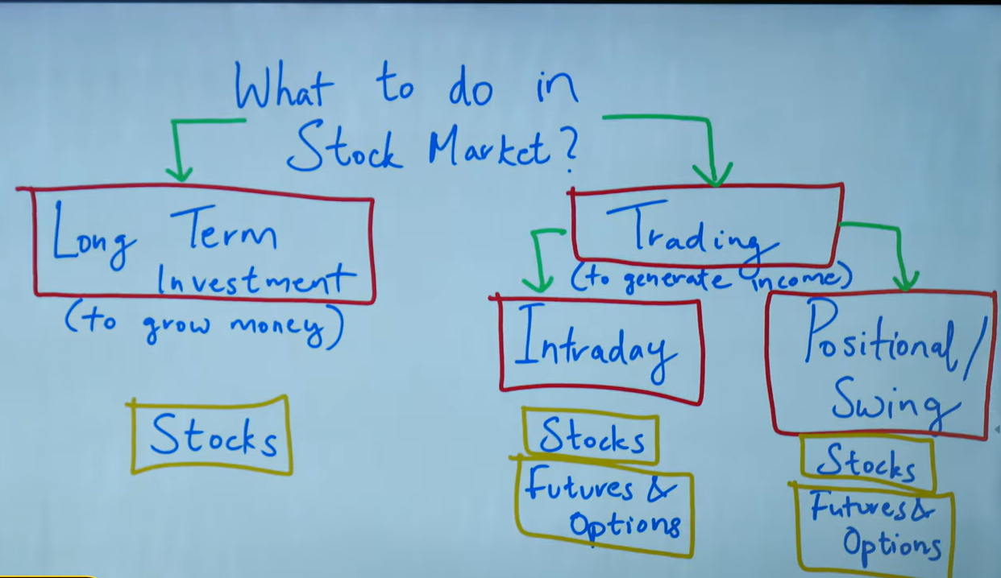

Slide 4



Slide 5


Slide 6



Slide 7


Slide 8



Slide 9



Slide 10
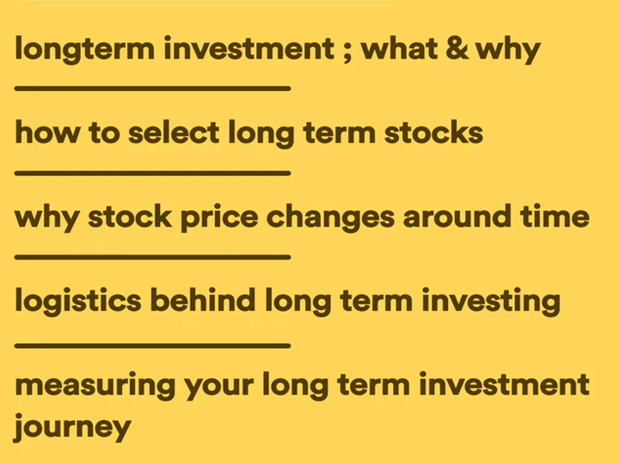

Slide 11


Slide 12



Slide 13


Slide 14


Slide 15

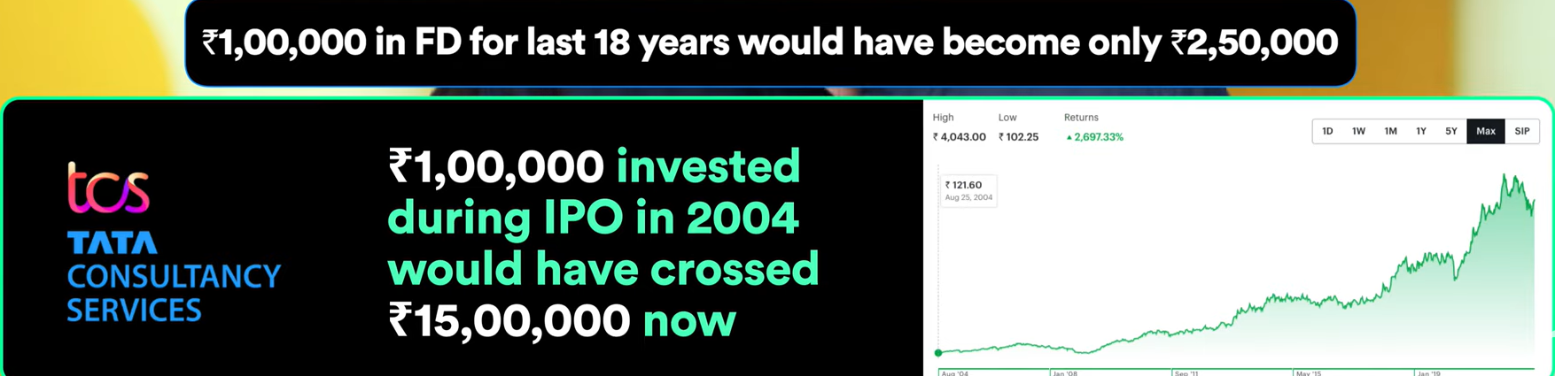

Slide 16
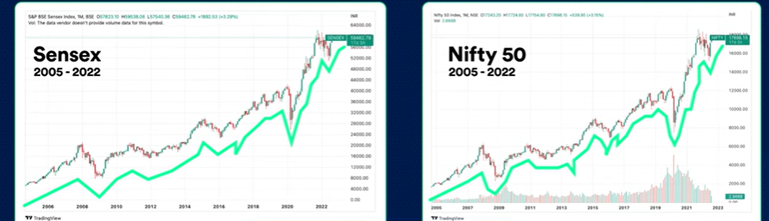

Slide 17


Slide 18



Slide 19


Slide 20


Slide 21






Slide 22


Slide 23



Slide 24


Slide 25


Slide 26



Slide 27
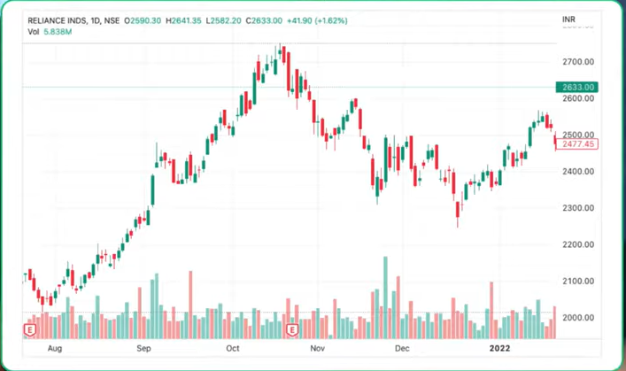


Slide 28


Slide 29


Slide 30




Slide 31

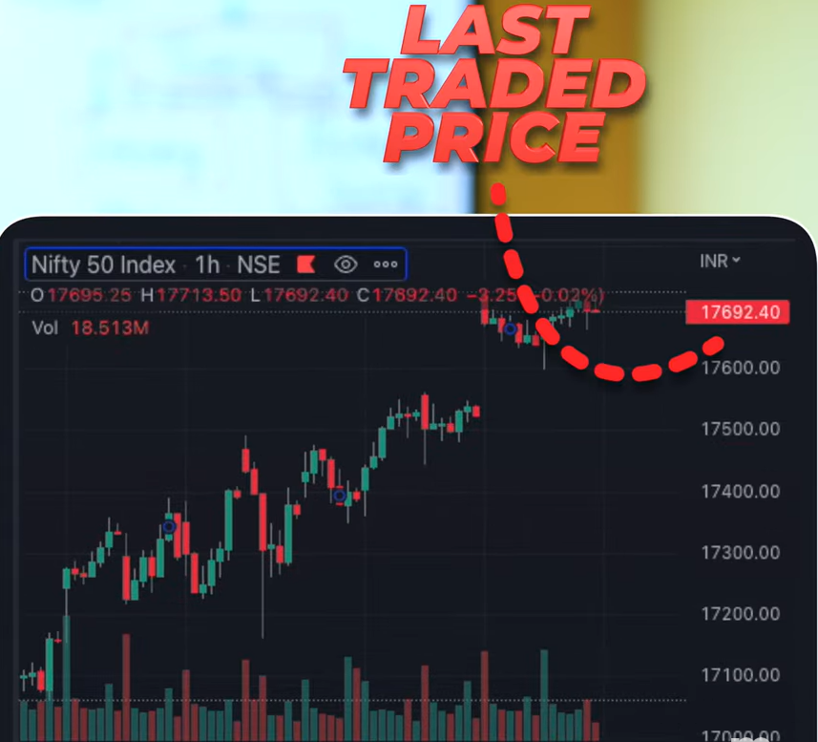

Slide 32




Slide 33



Slide 34



Slide 35


Slide 36



Slide 37
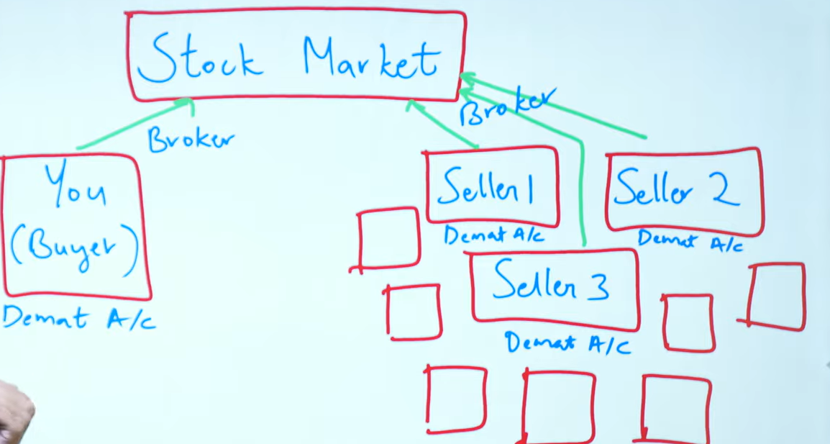

Slide 38


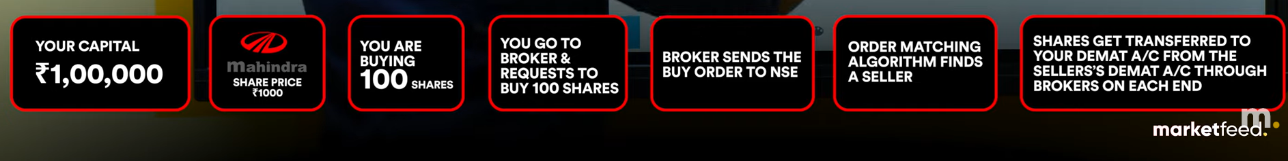

Slide 39




Slide 40


Slide 41


Slide 42


Slide 43



Slide 44



Slide 45
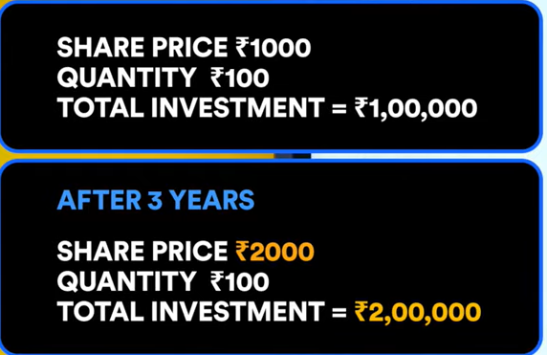
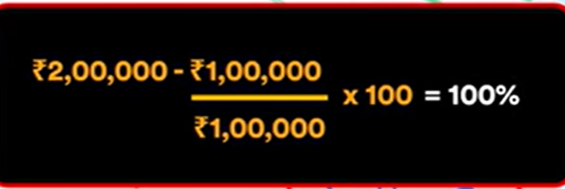


Slide 46


Slide 47
